Slide 1
N. Champetier visit – Saginaw Technical roadmap & Innovation
30 October 2015
Saginaw, Michigan

Slide 2
N. Champetier visit – Saginaw Technical roadmap & Innovation Content
Our approach to innovation
EPS building block roadmap
ADAS & Autonomous driving roadmap
None-Steering automotive projects

Slide 3
N. Champetier visit – Saginaw Technical roadmap & Innovation Content
Our approach to innovation
EPS building block roadmap
ADAS & Autonomous driving roadmap
None-Steering automotive projects

Slide 4


Our approach to innovation Value-Managed Technology
Develop technologies to meet future customers and business needs
Ensure technology for future market growth and strength
All EPS Engineering projects managed and tracked in Technology Roadmap
Weekly meetings with cross functional group
Projects assessed and prioritized based on overall value
High risk projects reviewed weekly, others based upon scheduled cadence
Responsive development process
Project requirements defined for each project – exit criteria and timing

Slide 5
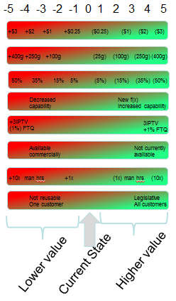
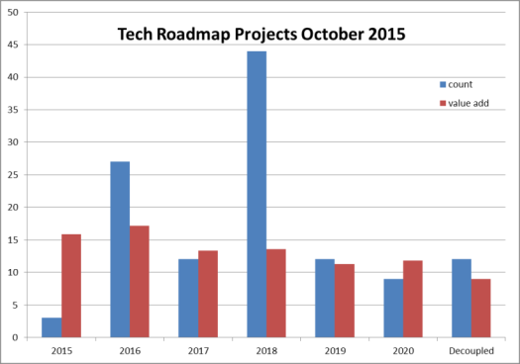
Our approach to innovation Value-Managed Technology
Value rating scale considers trade offs between attributes
120 Total Active Projects
13.5% Value Improvement average over current state
Value Attributes
Cost
Mass
Packaging
Performance
Quality
Value Stream/Risk Reduction
Developmental Efficiency
Growth Opportunity

Slide 6

Our approach to innovation Leverage our core competencies
Mechanical Integration
Power Electronics
Software
Algorithms
Motor Design
Sensor Design
What new products could we develop from these?
Systems Engineering
Closed Loop Servo Control
Safety Critical Product Creation from requirements
Ability to Industrialize

Slide 7
Our approach to innovation Technology Development and Work Flow
Maleki
Systems and Electrical
Chandy (previous role)
Bright
Singh
Zuraski
Future
Pursuit
Applications
Arnold
Sizelove
Core
Power Pack
Work is distributed (not all projects start in FE)
Roller

Slide 8
Our approach to innovation Technology Development and Work Flow
Milestone 0
Milestone 1
Milestone 2
Milestone 3
Milestone 4
Milestone 5
Closed
Process
New
Proof of Concept
DEV
DV
PV
Production
Review w/ Product Team
Concept
Product Team Review & Approval
Ready for Project Transfer
Validation in Process
Ready to Use –
On the Shelf
In a Program at SOP
No longer tracked by Tech Roadmap
Future
Zuraski
Staff Linkage
Core
Maleki, Sizelove
Core – CAT 1
Application
Singh
Closeout & Transfer Review(s)
Current / CIP
Burns, Davis
Big Bang Initiatives
Davis
CIP Advanced Planning Roadmap/Overlay
Linkage to Program Timing, Bundled Validation Windows
and Target SOP Windows
Supporting Activities
Note: Initiatives may go into Tech Roadmap if further development is required or directly to ECR/CR/CRB
Brush CIP Workshops
Huang
Red = Date Delayed
Risk Assessment
Yellow = Date at Risk
Green = Date on Track
Weekly Meetings to Review Status

Slide 9
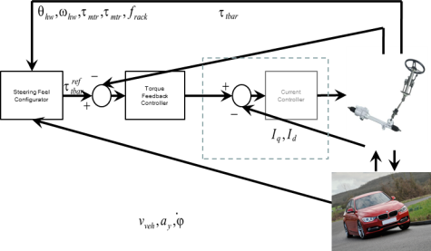

Our approach to innovation Key Project Drivers
MARKET TRENDS
71 projects positively impact our growth opportunity
Project Examples
Automated Driving Trends – 3 projects
Advanced Steering Features – 13 projects
Enhanced Safety Systems – 12 Projects

Slide 10
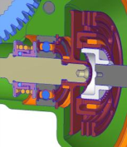
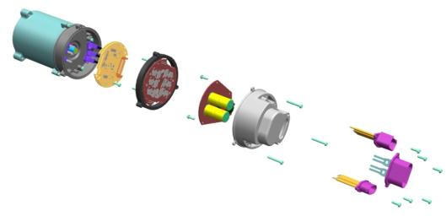
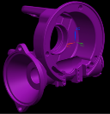


Our approach to innovation Key Project Drivers
PACKAGING
29 projects positively impact our packaging
Skewed worm axis
Overlapping A/M coupler
Radial Field MSB
Compact brush motor
Remote mounted controller
Remove isolation on worm axis
MASS
28 projects reduce system Mass
Plastic housing
Plastic pulleys
Hollow/Tubular racks
High ratio CEPS

Slide 11
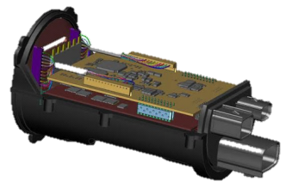

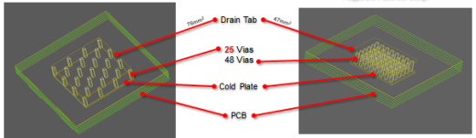
Our approach to innovation Key Project Drivers
COST IMPROVEMENTS
48 projects positively impact reducing our product cost
New Electrical Architecture
Support AutoSar 4 and ISO 26262
Plastic conversion of components
Synchronous reluctance motor
Power inverter optimization
Motor and Controller optimization

Slide 12
N. Champetier visit – Saginaw Technical roadmap & Innovation Content
Our approach to innovation
EPS building block roadmap
ADAS & Autonomous driving roadmap
None-Steering automotive projects

Slide 13
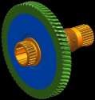
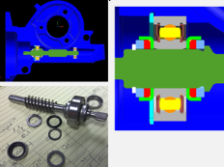

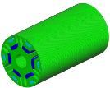



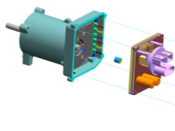

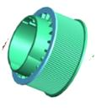

EPS building block roadmap Focus on SPEPS 2018 – 2022 timeframe
High gear ratio
Stiff worm shaft
Optimized sensor
Simplified stop teeth
Simplified lower rotor
PHA using FR4 PCB
Motor Rotor technology
Integrated Single Bearing BNA
Push-in power connections
EA4, CyberSec
Redundant MPP
Plastic driven pulley
Plastic drive pulley
2019
2020
2021
>2022

Slide 14
N. Champetier visit – Saginaw Technical roadmap & Innovation Content
Our approach to innovation
EPS building block roadmap
ADAS & Autonomous driving roadmap
None-Steering automotive projects

Slide 15
Nexteer Technologies Roadmap to Highly Automated Driving
Flying Cars
☺
Driver Override & Takeover
Input/Output Torque Overlay
HW Vibration Alert
Overlay Arbitration
Hands On/Off Wheel Detect
Cyber-security Features
Road Surface Detection
Driver Monitoring
Level 4 City Driving
Level 5 / Driverless Cars
Level 3 Highway Driving
Level 4 Highway Driving
Lane Change Assist
Level 2 Highway Driving
Traffic Jam Assist
Trailer Backup Assist
Lane Keeping Assist
LEGEND
Basic EPS
Auto Parking Assist
Lane Departure Warning
Embedded Black Box OEM Functions
Vehicle Features
Vehicle Stability Assist
Under- / Over-Steer Assist
Nexteer Technologies
Quadrasteer
Low Speed Strg Position Control
Steering Feel Dynamic Modulation
AUTOSAR
ISO26262 Safety Architecture
Fail Operational HW/SW
State of Health Monitoring
High-speed Position Tracking
Steer-by-Wire
Enhanced Steering HMI Interfaces
2000 2020 20xx
Notes:
1999: Basic EPS
2002: Quadrasteer on GM Pickups – First steer-by Wire
2007: Automatic Parking on Ford Escape
2008: DSR for vehicle stability on Ford Mondeo / Fiat ?
2018: Cybersecurity : Secure Diagnostics, Secure Lock, Secure Programming. etc.

Slide 16
ADAS & Autonomous driving roadmap Loss of assist mitigation : motivation
Core EPS assist function
Sudden transition to the LoA state may be uncomfortable and have a startle effect on the driver
The increased steering effort associated with LoA may result in incorrect driver perception that the vehicle is not steerable
Some applications are assigning an ASIL rating to Loss of Assist
ADAS and Autonomous Driving functions
Functions such lane centering, collision avoidance, autonomous driving, etc. may not rapidly terminated in the event of a fault until the driver has taken over the task
Reverting to manual steering may not be an acceptable safe state with ASIL rating assigned

Slide 17
ADAS & Autonomous driving roadmap NHTSA Proposed Levels
No-Automation (Level 0) – driver is in complete control of the primary vehicle controls – brake, steering, throttle and motive power – at all times.
Function-Specific (Level 1) – automation at this level involves one or more specific control functions
Combination Function Automation (Level 2) – at least two primary control functions designed to work in unison to relieve driver
Limited Self-Driving Automation (Level 3) – driver is expected to be available for occasional control, but with sufficiently comfortable transition time
Full Self-Driving Automation (Level 4) – driver expected not to be available at any time during trip
Notes:
DELETE?

Slide 18
ADAS & Autonomous driving roadmap Loss of assist mitigation : Possible solutions
Reduce occurrence rate or reduce fault severity
Fault
Full Assist Performance
Reduced Assist Performance
Shutdown
“Limp Home”
Ramp Out
Immediate Off
“Limp Aside”
Other Reduced Functionality (Non-Assist)
Reduced Occurrence Rate / Full Functionality
Component & Rating Selection
Hardware Redundancy
Software / Diagnostics Design
Mech Design / Mfg & Quality Processes
Med/High performance SW backup function
Low performance SW backup function
No backup, but ramping capable
No backup or ramping available
Diagnostics Robustness
NO LoA
Current Design
Failure Rate Requirement
Minimum Fault Severity Requirement
Acceptable Solutions
Future Design
LoA

Slide 19
ADAS & Autonomous driving roadmap Loss of assist mitigation : HW & SW solution sets
1V5
Decreasing Severity with Fault Present

Slide 20
ADAS & Autonomous driving roadmap Loss of assist mitigation : Progressive improvement of FIT

Slide 21
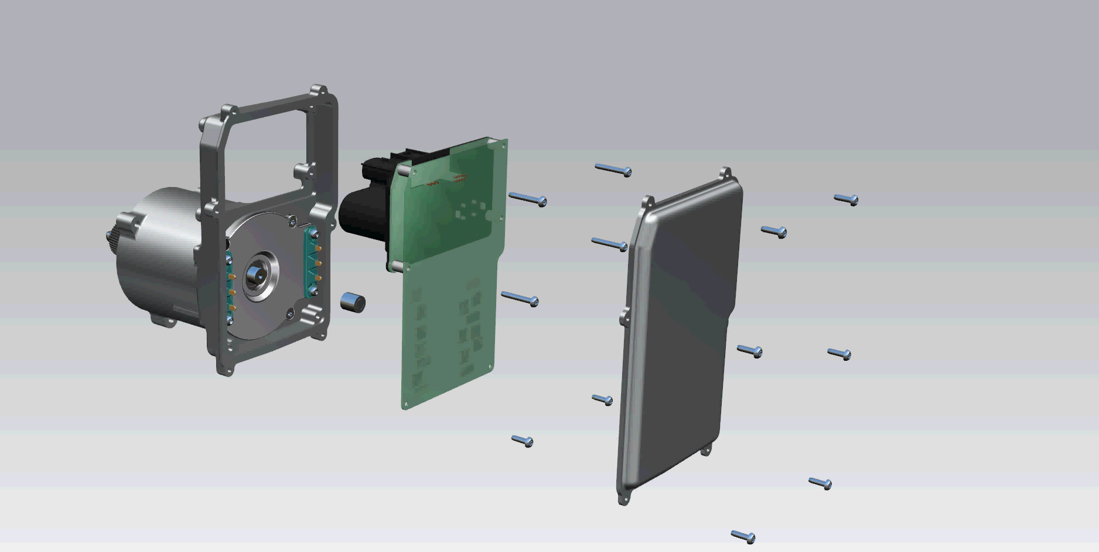
ADAS & Autonomous driving roadmap Loss of assist mitigation : Fully populated LoA-mitigation MPP
Construction remains fully consistent with Nexteer MPP Bill of Process
Notes:
Which type of system is this?

Slide 22
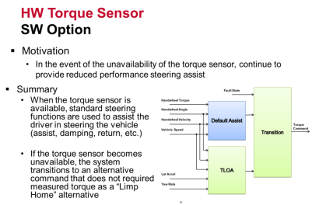
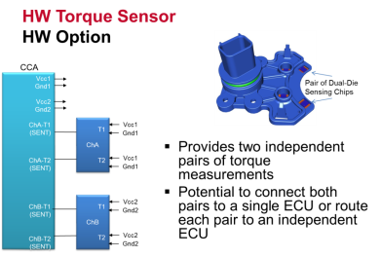
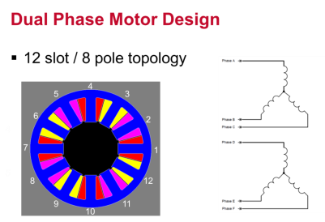
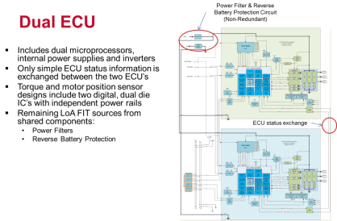
ADAS & Autonomous driving roadmap Loss of assist mitigation : Technology examples

Slide 23
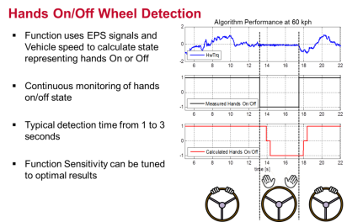
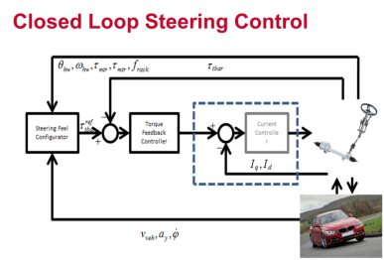
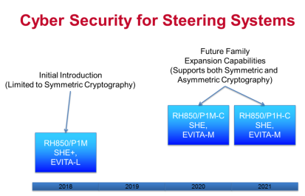
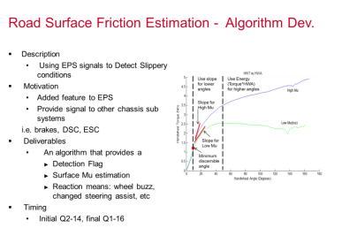
ADAS & Autonomous driving roadmap Selected enabling steering technologies

Slide 24
ADAS & Autonomous driving roadmap Steer-by-wire : Background & Current state
10 years since last Nexteer SBW project (joint project with BMW)
Decision in 2014 to initiate new SbW project
What is different since last projects:
LOA countermeasures / Fail Operational building blocks available
Many common control functions with Close Loop Steering Control
Other needed features available – ex. Potentially use Simulated Travel Stops for hand wheel actuator
Dual power source available on subset of vehicles
Electronics cost on a downward trend
ADAS Features Evolution
Building functional prototype with available production components
REPS for road wheel actuator
CEPS for hand wheel actuator
Develop in phases:
1st focus on base steering functions
2nd explore new features enabled with extra degree of freedom
Will develop production intent design concept in parallel
Safety architecture
Optimized component sizing, mechanical functional content

Slide 25
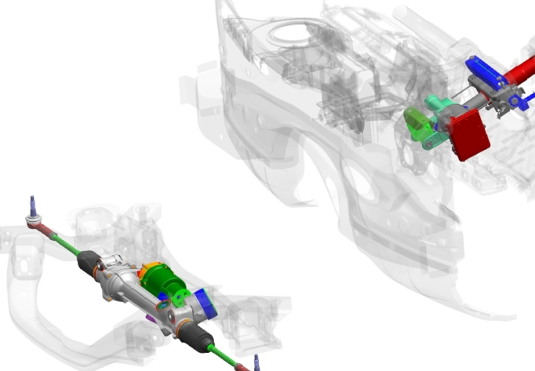
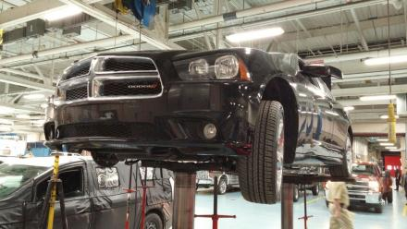
ADAS & Autonomous driving roadmap Steer-by-wire : Development vehicle
CEPS Column for Gear Inputs and Steering Feel
No I-shaft Required
REPS Gear for Vehicle Steering
Notes:
Modified - title

Slide 26
N. Champetier visit – Saginaw Technical roadmap & Innovation Content
Our approach to innovation
EPS building block roadmap
ADAS & Autonomous driving roadmap
Non-Steering automotive projects

Slide 27
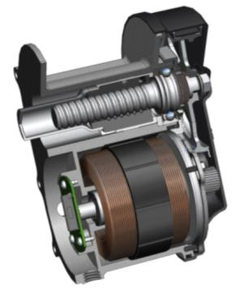
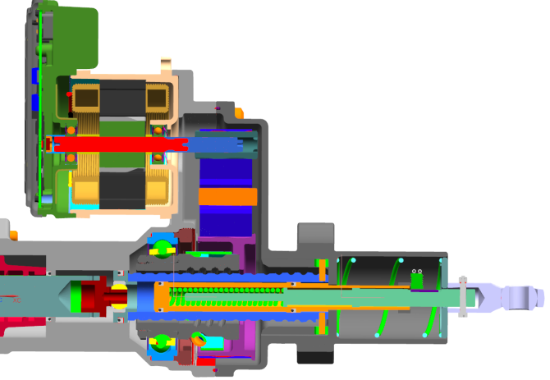
ADAS & Autonomous driving roadmap Non-Steering automotive projects : Electric Brake Booster

Slide 28
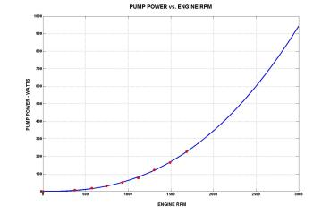
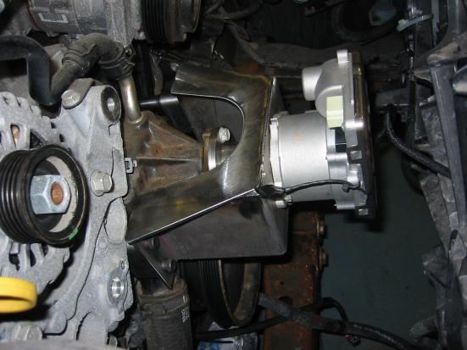
ADAS & Autonomous driving roadmap Non-Steering automotive projects : Electric Cooling Pump

